Slide 1
Digital Portfolio
STUDENT NAME: KOWSALYA V
REGISTER NO AND NMID: 212406244 / A4F7C2A95E97417B0B34413D0188E688
DEPARTMENT: COMPUTER APPLICATION
COLLEGE: MAGNA COLLEGE OF ARTS AND SCIENCE /University of Madras

Slide 2
PROJECT TITLE
PERSONAL DIGITAL PROTFOLIO

Slide 3


AGENDA
Problem Statement
Project Overview
End Users
Tools and Technologies
Portfolio design and Layout
Features and Functionality
Results and Screenshots
Conclusion
Github Link
3/21/2024 Annual Review

Slide 4

PROBLEM STATEMENT
Many job seekers struggle to showcase their skills, projects, and achievements in a clear and visually appealing way, which reduces their chances of standing out to potential employers."

Slide 5

PROJECT OVERVIEW
A personal digital portfolio designed to showcase my skills, projects, and achievements in a structured and visually engaging way, helping me build a strong professional presence and stand out to employers.

Slide 6

WHO ARE THE END USERS?
Employers & Recruiters – who want to evaluate my skills, projects, and achievements quickly.
Clients & Collaborators – who may be interested in working with me on professional or freelance projects.
Peers & Academic Mentors – who can review my work, provide feedback, or assess academic progress.
General Audience / Network – anyone interested in learning about my skills, expertise, or career journey.

Slide 7

TOOLS AND TECHNIQUES
Web Technologies: HTML5, CSS3, JavaScript
Frameworks & Libraries: React.js /CSS (for responsive design)
Design Tools: VS CODE
Version Control: Git & GitHub (for code management and hosting)
Hosting Platforms: GitHub Pages

Slide 8
POTFOLIO DESIGN AND LAYOUT
The structure is divided into clear sections to highlight my professional profile:
Homepage – A brief introduction with a tagline and profile photo.
About Me – Summary of background, career goals, and key strengths.
Skills – Technical and professional skills presented with icons/visuals.
Projects – Showcasing major works with descriptions, problem statements, and solutions.
Resume/CV – Downloadable or interactive version of my curriculum vitae.
Contact Section – Links to email, LinkedIn, GitHub, and social media.
8

Slide 9
FEATURES AND FUNCTIONALITY
Clean homepage with intro & tagline
About Me section with career highlights
Skills showcase with visuals/icons
Projects display with details
Resume view & download option
Contact form + social links
Fully responsive design
Easy navigation & smooth scrolling

Slide 10
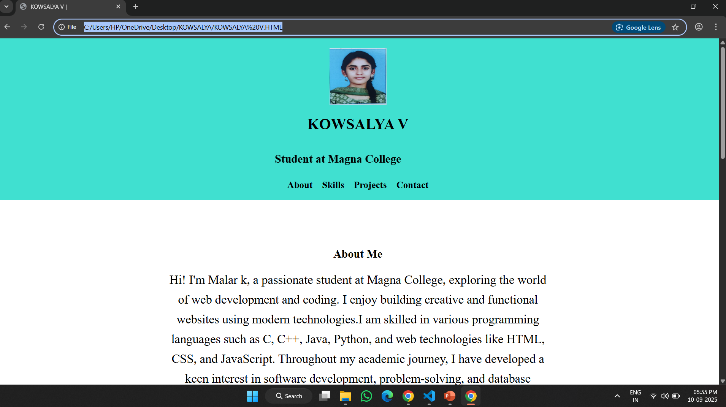

RESULTS AND SCREENSHOTS
3/21/2024 Annual Review
10

Slide 11
CONCLUSION
This digital portfolio showcases my skills, experiences, and creative journey, reflecting both my professional growth and personal development. It demonstrates my commitment to continuous learning, adaptability, and the ability to translate ideas into tangible outcomes. Through this portfolio, I aim to communicate not only what I have achieved but also the potential I bring to future opportunities. I hope it provides a clear insight into my capabilities, work ethic, and passion for excellence.
11

